Slide 1
Introduction to Data Warehouse & Data Mining

Slide 2
What is Data Warehouse and Data Mining?
Data Warehouse:
A data warehouse is a large, centralized storage system that collects, stores, and manages data from various sources. It’s designed to support business decision-making.
It helps organizations consolidate data from different places, making it easy to analyze and generate reports.

Slide 3
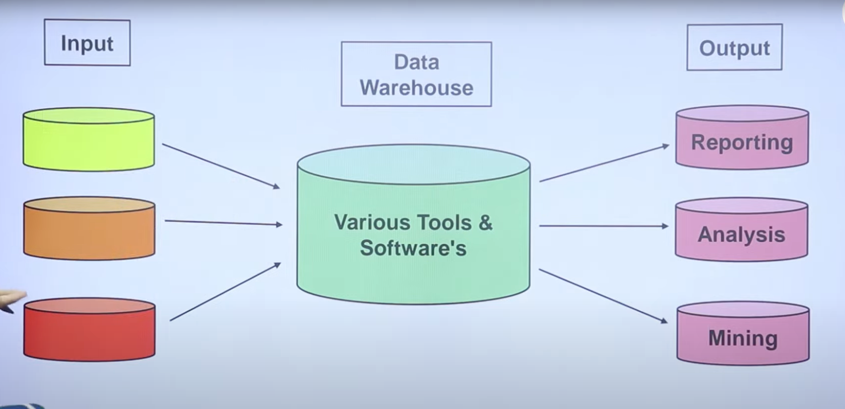
What is Data Warehouse and Data Mining?
Data Warehouse:

Slide 4
Why Data Warehouse?

Slide 5
Business Questions
Imagine a corporate executive of a national electronics retailer asking the question, "What retail stores were the top producers during the past 12 months in the Rocky Mountain region?"

Slide 6
Business Questions
Follow-up questions may include, "What were the most profitable products in the top producing stores?" and "What were the most successful product promotions at the top producing stores?"
These are examples of typical decision support or business intelligence questions, asked every day by managers all over the world.

Slide 7
Shortcomings of SQL
Answers to these questions often require complex SQL statements that may take hours to code and execute.
Further more, formulating some of these queries may require data from a diverse set of internal legacy systems and external market sources, involving both relational and nonrelational databases.

Slide 8
Need for New Technology
Decision-making questions such as those above pose new requirements on DBMSs.
Data warehouse technology complements and extends relational database technology beyond online transaction processing and simple query capabilities such as the GROUP BY clause in SQL.

Slide 9
What are the Benefits?
Tangible benefits from a data warehouse can include :
Increased revenue and reduced expenses enabled by business analysis that was not possible before the data warehouse was deployed.
For example, a data warehouse may enable reduced losses due to improved fraud detection, improved customer retention through targeted marketing, and reduction in inventory carrying costs through improved demand forecasting.

Slide 10
Characteristics of Data Warehouse
Subject-Oriented: A data warehouse is organized around the major business subjects or entities such as customers, orders, and products.
This subject orientation contrasts to the more process orientation for transaction processing.

Slide 11
Characteristics of Data Warehouse
Integrated: Operational data from multiple databases and external data sources are integrated in a data warehouse to provide a single, unified database for decision support.
Consolidation of data requires consistent naming conventions, uniform data formats, and comparable measurement scales across databases and external data sources.

Slide 12
Characteristics of Data Warehouse
Time-Variant: Data warehouses use time stamps to represent historical data.
The time dimension is critical for identifying trends, predicting future operations, and setting operating targets.
Data warehouses essentially consist of a long series of snapshots, each of which represents operational data captured at a point in time.

Slide 13
Characteristics of Data Warehouse
Non-volatile: New data in a data warehouse are appended, rather than replaced, so that historical data are preserved.
The act of appending new data is known as refreshing the data warehouse.
Lack o f update and delete operations ensures that a data warehouse is free o f update or deletion anomalies.
Transaction data are transferred to a data warehouse only when most updating activity has been completed.

Slide 14
Data Mining:
Data mining is the process of discovering patterns, trends, and insights from large sets of data.
It helps organizations make predictions, understand customer behavior, and uncover hidden relationships in data.

Slide 15
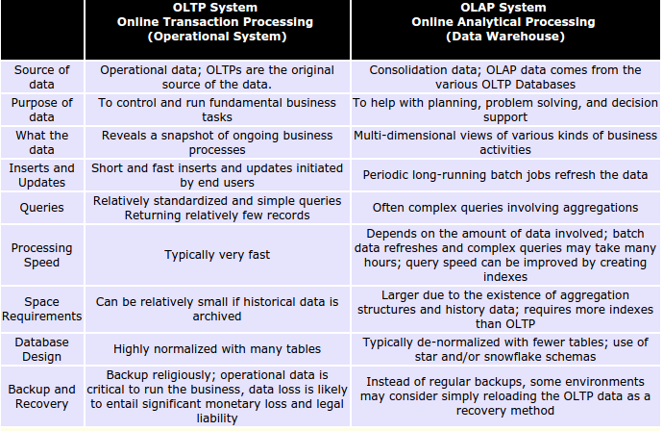
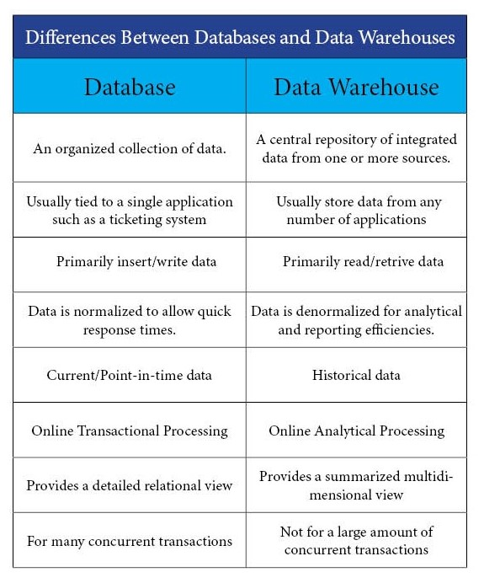
Database Vs Data Warehouse

Slide 16
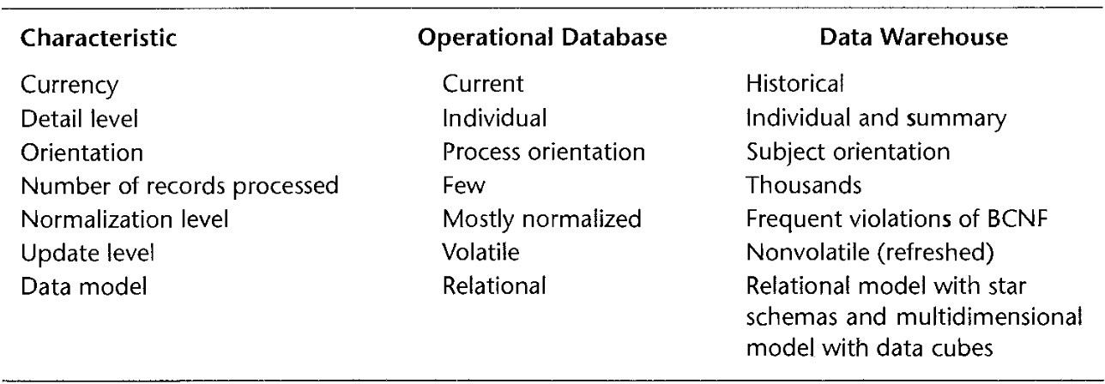
Operational Database Vs. Data Warehouse

Slide 17
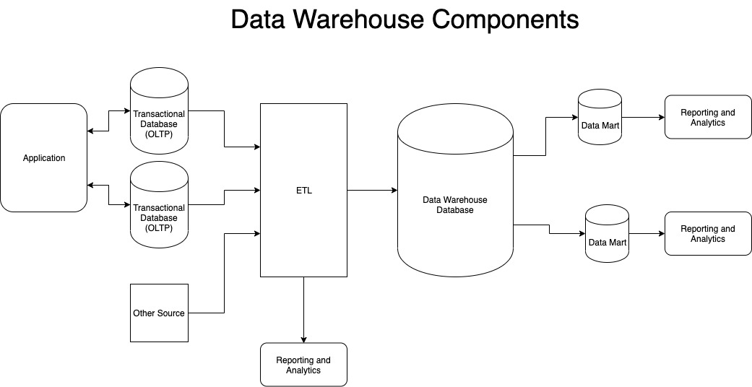
Data Warehouse Components

Slide 18
Data warehouse benefits
Data warehouses provide many benefits to businesses. Some of the most common benefits include:
Provide a stable, centralized repository for large amounts of historical data
Improve business processes and decision-making with actionable insights
Increase a business’s overall return on investment (ROI)
Improve data quality
Enhance BI performance and capabilities by drawing on multiple sources
Provide access to historical data business-wide
Use AI and machine learning to improve business analytics

Slide 19
Data Mining:
Data mining is the process of discovering patterns, trends, and insights from large sets of data.
It helps organizations make predictions, understand customer behavior, and uncover hidden relationships in data.

Slide 20
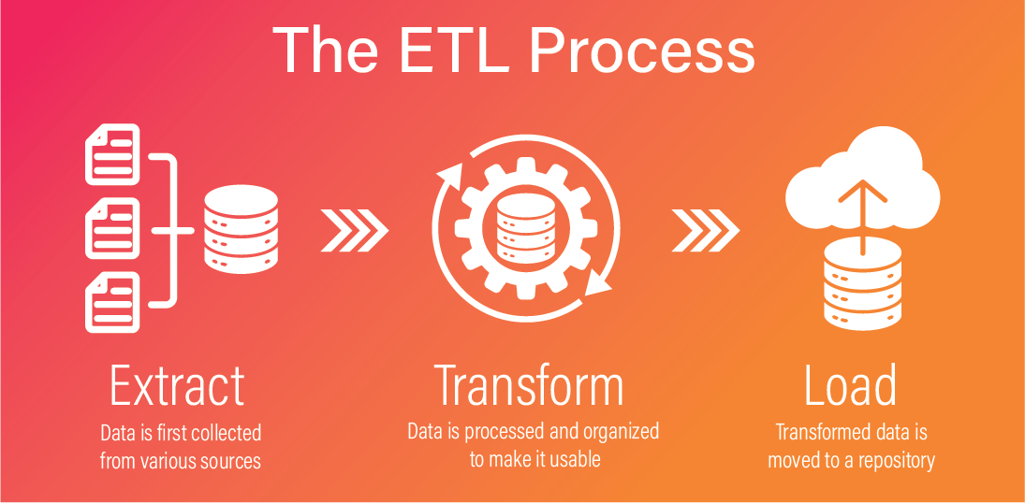
ETL (Extract-Transform-Load)

